Slide 1

Effects of Security Measures on School Personnel
Matthew J. Cuellar, PhD, MSW
Wurzweiler School of Social Work

Slide 2


AGENDA: TWO-PART PRESENTATION
How do school social workers perceive school security measures?
How are school social workers “affected” by school security measures?

Slide 3


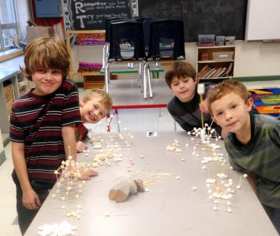
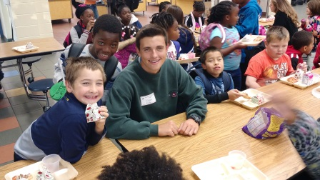
WHAT IS SCHOOL SOCIAL WORK?

Slide 4
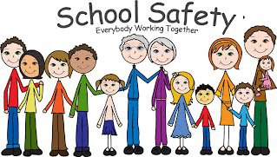
PERCEPTIONS TOWARD SCHOOL SECURITY MEASURES
Cuellar, Elswick, & Theriot (2017)
Cuellar & Mason (2018)

Slide 5
CUELLAR, ELSWICK, & THERIOT (2017)

Slide 6
CUELLAR & MASON (2017)

Slide 7

EFFECTS OF SCHOOL SECURITY MEASURES
Cuellar & Theriot (2017)
Lee & Cuellar (under review)

Slide 8
CUELLAR & THERIOT (2017)

Slide 9
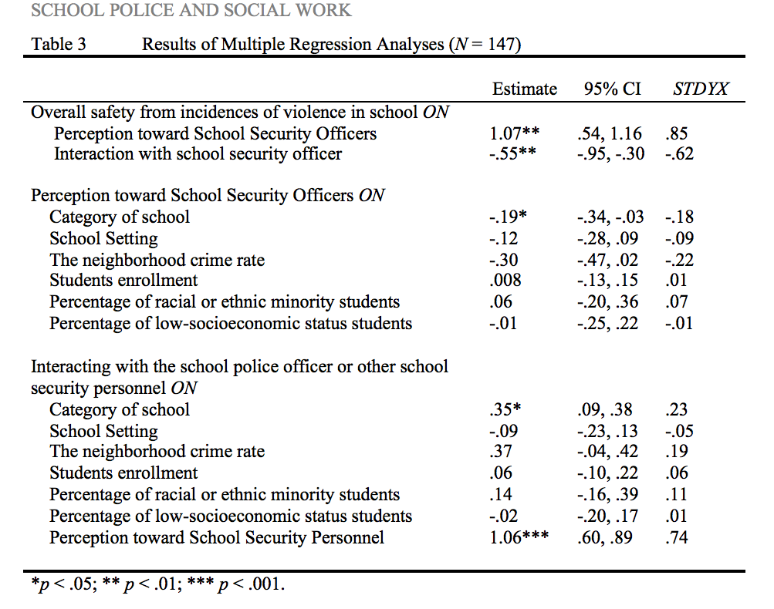
LEE & CUELLAR (under review)

Slide 10
Questions?

